Slide 1
Automated Testing in Production Planning in Test based Engineering
Hackathon 2021 Problem Statement

Slide 2
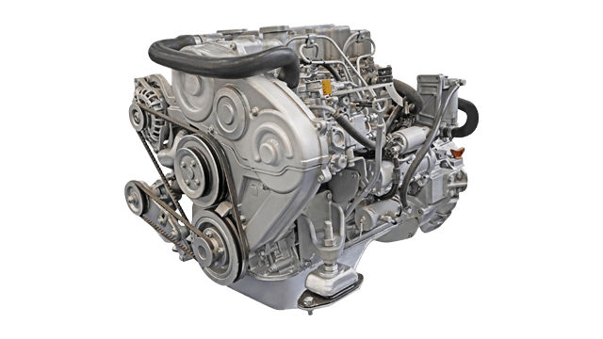
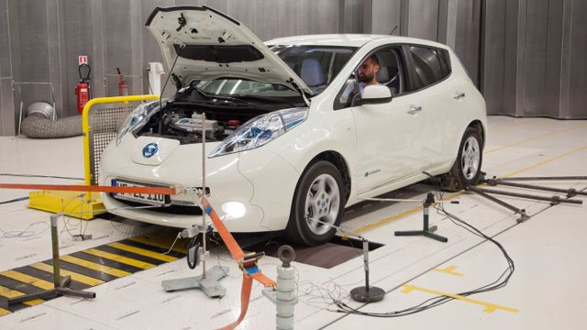
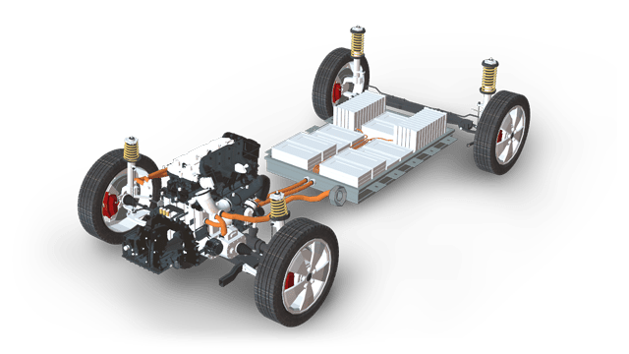
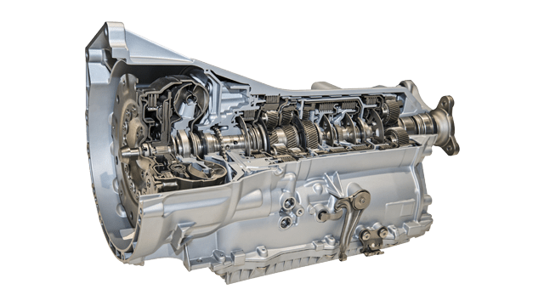
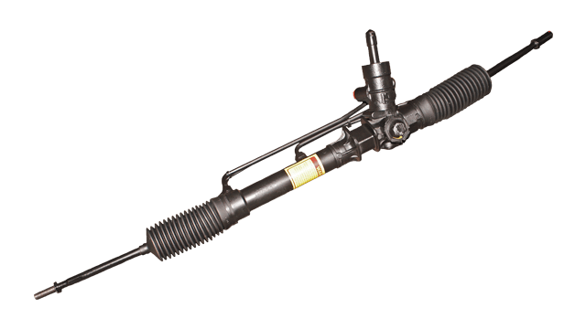
(H) EV Powertrain Component categories
Powertrain sensors
Powertrain current sensors
Powertrain exhaust sensors
Powertrain fluid concentration sensors
Powertrain knock sensors
Powertrain position sensors
Engine
Diesel engine
Engine fan
eTurbo/charger
Gasoline & diesel engine platform
Gasoline engine
Ignition
Pump
Transmission
Automatic transmission
Drive line components
Electric drive
Shifter system
Power Steering
Electric power steering (EPS)

Slide 3
Test IDs and time taken to perform tests (* All the data is anonymous)
Training Data: All parts are randomly shuffled
Test ID | Time taken to perform test | Variables
 |  | Categorical Variables |  | Continuous Variable | Continuous Variable |  | Binary Variables
ID | y | X0 | X1 | X9 | X10 | X16 | X17 | X18
0 | 130.81 | k | v | 0.207113 | 0.102098 | 0.777778 | 0 | 1
6 | 88.53 | k | t | 0.504978 | 0.017506 | 0.777778 | 0 | 1
7 | 76.26 | az | w | 0.392335 | 0.003765 | 0.777778 | 1 | 0
9 | 80.62 | az | t | 0.474729 | 0.008185 | 0.333333 | 0 | 0
13 | 78.02 | az | v | 0.10188 | 0.00549 | 0.111111 | 0 | 0
18 | 92.93 | t | b | 0.554858 | 0.023466 | 0.444444 | 0 | 0
24 | 128.76 | al | r | 0.213276 | 0.096429 | 0.111111 | 0 | 0
25 | 91.91 | o | l | 0.198462 | 0.022033 | 1 | 0 | 0
27 | 108.67 | w | s | 0.664776 | 0.049814 | 0.111111 | 0 | 0
30 | 126.99 | j | b | 0.253765 | 0.091677 | 0 | 0 | 0
Engine
Diesel engine
Engine fan
eTurbo/charger
Gasoline & diesel engine platform
Gasoline engine
Ignition
Pump

Slide 4
Data Exploration and Time prediction
Test Data
Pattern Recognition
Test ID | Variables
 | Categorical Variables |  | Continuous Variable |  |  | Binary Variables
ID | X1 | X2 | X9 | X10 | X16 | X17
1 | az | v | 0.260169 | 0.007526 | 0.666667 | 0
2 | t | b | 0.118023 | 0.031068 | 0.222222 | 0
3 | az | v | 0.262278 | 0.009687 | 0.888889 | 0
4 | az | l | 0.184351 | 0.004481 | 0.888889 | 0
5 | w | s | 0.674921 | 0.054433 | 0.555556 | 0
8 | y | aa | 0.202338 | 0.020781 | 0.666667 | 0
10 | x | b | 0.169923 | 0.052427 | 0.777778 | 0
11 | f | s | 0.41488 | 0.025004 | 0.555556 | 0
12 | ap | l | 0.363767 | 0.067247 | 1 | 0
14 | o | v | 0.169764 | 0.025004 | 0.888889 | 0
Machine Learning approach selection
Model comparison and Evaluation
Model comparison and Evaluation

Slide 5
(H) EV Powertrain Testing
Each test ID is divided into categories (A1 – A6) which resemble a component in powertrain machinery. For successful testing of the powertrain machinery, test IDs from these categories should be tested on specific machines in a specific order of component categories.
113 → 1241 → 7623 → 8091 → 1466 → 4211
113 | N | N | N | N | Y | N
1241 | Y | N | N | N | N | N
7623 | N | N | Y | N | N | N
8091 | N | N | N | Y | N | N
1466 | N | Y | N | N | N | N
4211 | N | N | N | N | N | Y
M 1
M 2
M 3
M 4
M 5
M 6

Slide 6
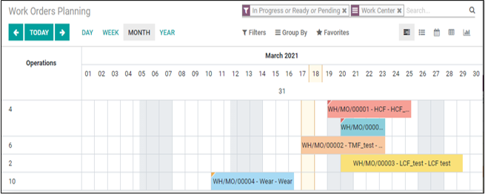
Test Planning and Scheduling tool output
Test Sequence 1 – Machine used, time for execution, resources used, resources available
Test Sequence 2 – Machine used, time for execution, resources used, resources available
All the test sequences should be in the increasing order of start date and total time required
Test Sequences
Machine Selector
Test Planner

Slide 7
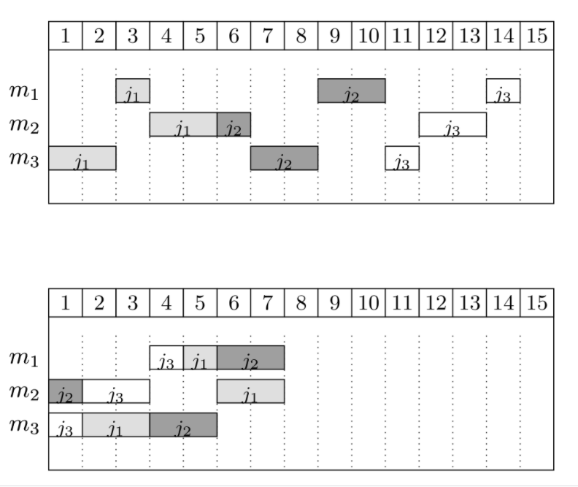
Scheduling Problem – 2 approaches
test t1: m3 (2) → m1 (1) → m2 (2)
test t2: m2 (1) → m3 (2) → m1 (2)
test t3: m3 (1) → m2 (2) → m1 (1)
The first schedule shows a naive solution: jobs are processed in a sequence and machines stay idle quite often
The second solution is the optimal one, where jobs execute in parallel.
First Solution
Second Solution

Slide 8
Summary
Task 1:
Data Exploration and Analysis
Data Modelling and Approach comparison
Predict testing time per Test ID using machine learning techniques
Performance Analysis using R2 score
Task 2:
Map Machines with Test IDs and testing time
Write logic to schedule tests on machines with predicted test times
Minimize the makespan, i.e. minimize the maximum completion time among all tests
Keep count of resources available

